Slide 1
Causes of the First World War

Slide 2
On 28 June 1914, Franz Ferdinand, heir to the Austrian throne, was assassinated with his wife in Sarajevo, the capital of the Austro-Hungarian province of Bosnia.
How could the murder of this man lead to the First World War?

Slide 3
military build-up
war hysteria
naval race
militarism
conflicts
feelings of superiority
nationalism
WW1
imperialism
Balkan Wars
alliances
imperial rivalries
blank check
mistrust
powers drawn into war
idea of war omnipresent

Slide 4
WW1

Slide 5
militarism
WW1

Slide 6
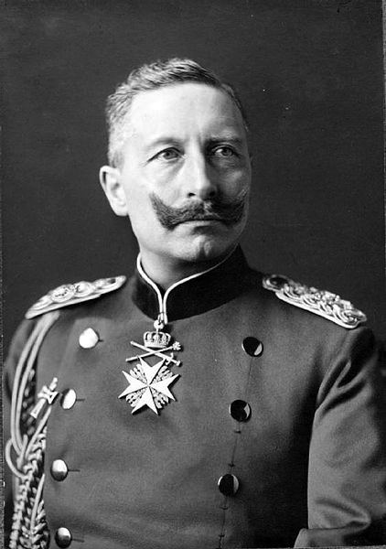
Wilhelm II
Notes:
image: http://en.wikipedia.org/wiki/File:Kaiser_Wilhelm_Ii_and_Germany_1890_-_1914_HU68367.jpg

Slide 7
Wilhelm II’s Weltpolitik
wanted to turn Germany into a world power
aggressive German foreign policy
naval race between Britain and Germany
rivalry between Britain and Germany, war hysteria
Notes:
Also imperial ambitions → colonies, conflicts over colonies etc.

Slide 8
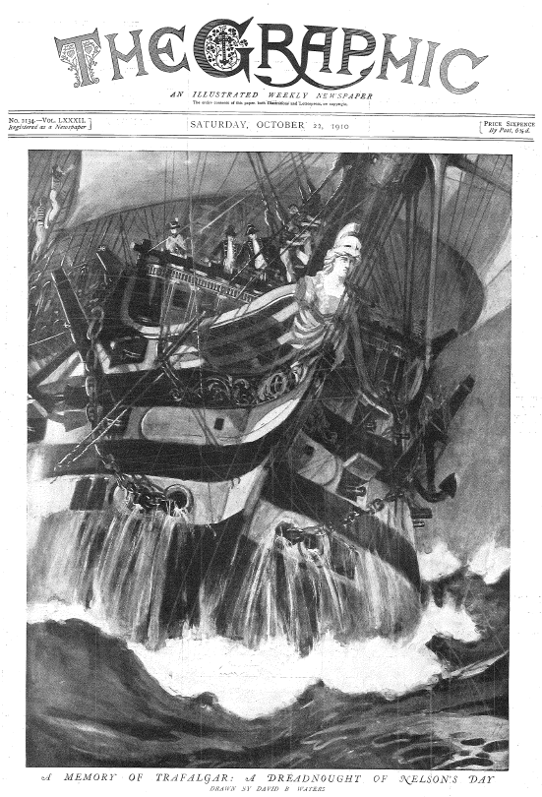
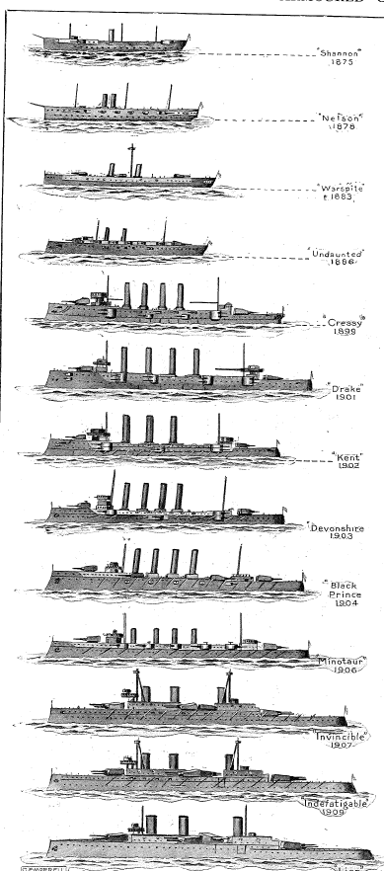
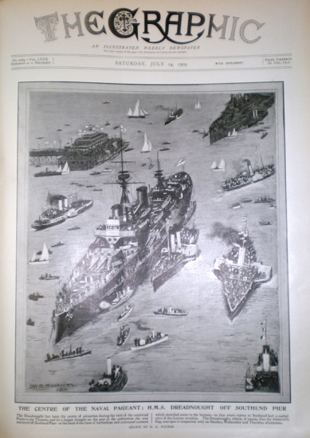
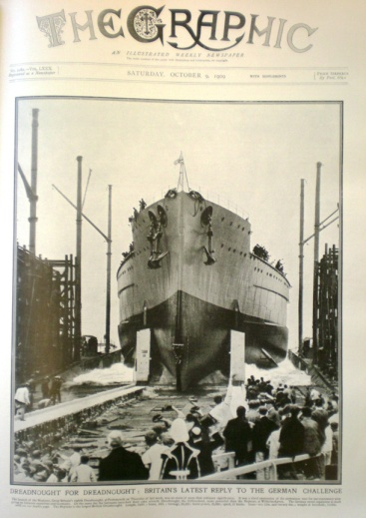
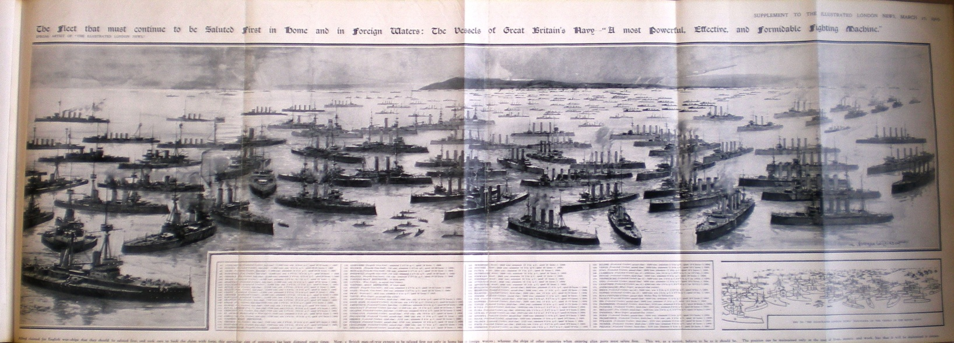
The Graphic 22.10.1910
Graphic 24.6.1909
The Graphic 9.10.1909
Illustrated London News 27.3.1909
Notes:
the British press was obsessed with dreadnoughts and the naval race
(all photographs by Ariane Knüsel)

Slide 9
naval race
militarism
WW1

Slide 10
Notes:
Source: Graham Darby. Origins of the First World War. Harlow, 2003. (adapted)

Slide 11
military build-up
naval race
militarism
WW1

Slide 12
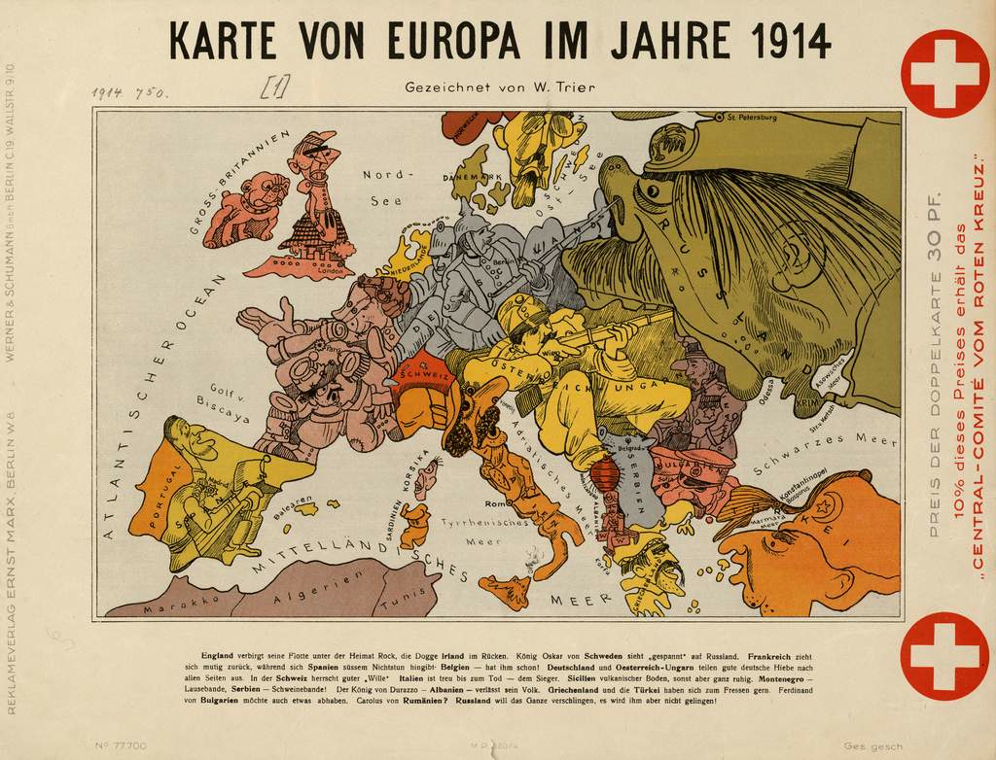
Notes:
War hysteria
http://www.smb.museum/presse/pressebilder/pressebilder-downloaden.html?tx_smb_pi1%5Bpressfolder%5D=44
Walter Trier (1890-1951) Karte von Europa im Jahre 1914 38 x 24 cm, Maßstab ca. 1:12.000.000

Slide 13
military build-up
war hysteria
naval race
militarism
WW1

Slide 14
military build-up
war hysteria
naval race
militarism
WW1
imperialism

Slide 15
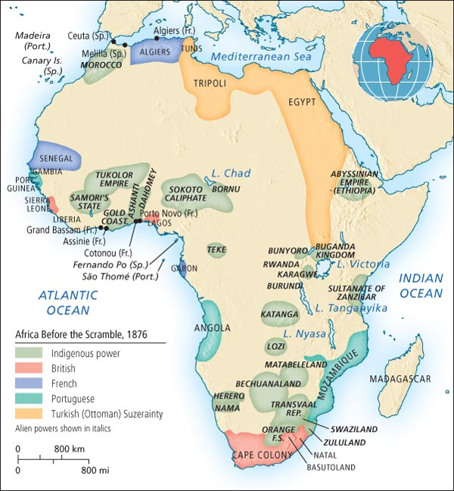
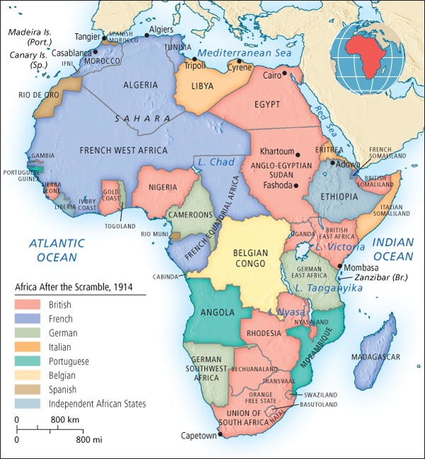
Scramble for Africa
Notes:
images:
http://wps.pearsoncustom.com/wps/media/objects/2426/2484749/chap_assets/maps/atl_map26_3.html
http://wps.pearsoncustom.com/wps/media/objects/2426/2484749/chap_assets/maps/atl_map26_4.html

Slide 16
military build-up
war hysteria
naval race
militarism
WW1
imperialism
imperial rivalries

Slide 17
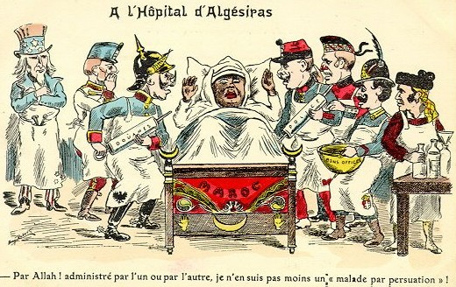
Notes:
image: http://upload.wikimedia.org/wikipedia/de/5/53/Marokko2.jpg

Slide 18
military build-up
war hysteria
naval race
militarism
conflicts
WW1
imperialism
imperial rivalries

Slide 19
military build-up
war hysteria
naval race
militarism
conflicts
WW1
imperialism
alliances
imperial rivalries

Slide 20
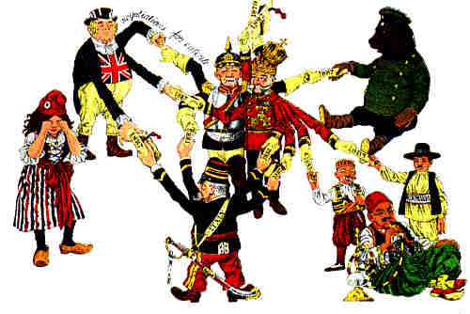
Notes:
image: http://www.worldwar1.com/tlwarorg.htm
→ handout alliances
European balance of power in 19th century was based on an alliance system (often named after the German Chancellor Bismarck)
By 1914 two groups of alliances: France, Britain and Russia (“Entente”) vs. Germany, Austria-Hungary and Ottoman Empire (“Dreibund”)
Alliance system had the effect that powers mistrusted each other and that the idea of war was omnipresent

Slide 21
military build-up
war hysteria
naval race
militarism
conflicts
WW1
imperialism
alliances
imperial rivalries
mistrust

Slide 22
military build-up
war hysteria
naval race
militarism
conflicts
WW1
imperialism
alliances
imperial rivalries
mistrust
idea of war omnipresent

Slide 23
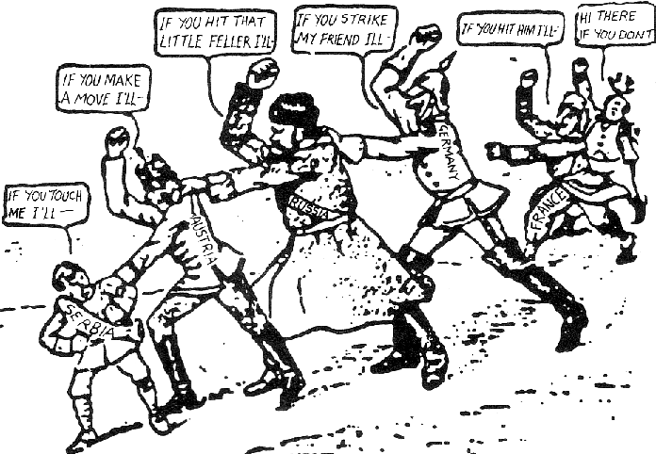
Notes:
This cartoon - 'A Chain of Friendship' - appeared in the American newspaper the Brooklyn Eagle in July 1914. The caption read: “If Austria attacks Serbia, Russia will fall upon Austria, Germany upon Russia, and France and England upon Germany.”
http://www.johndclare.net/causes_WWI4.htm

Slide 24
military build-up
war hysteria
naval race
militarism
conflicts
WW1
imperialism
alliances
imperial rivalries
mistrust
powers drawn into war
idea of war omnipresent

Slide 25
blank check
Notes:
image: http://www.dailymail.co.uk/news/article-2522901/Tonia-Dolison-New-Jersey-steals-blank-check-man-date.html
→ handout “Blank Check”

Slide 26
military build-up
war hysteria
naval race
militarism
conflicts
WW1
imperialism
alliances
imperial rivalries
blank check
mistrust
powers drawn into war
idea of war omnipresent

Slide 27
military build-up
war hysteria
naval race
militarism
conflicts
nationalism
WW1
imperialism
alliances
imperial rivalries
blank check
mistrust
powers drawn into war
idea of war omnipresent

Slide 28
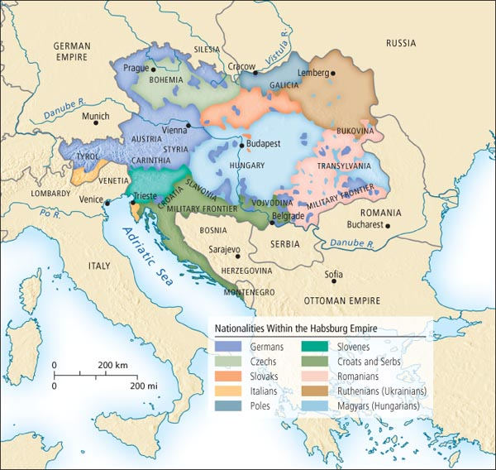
Notes:
nationalism spread in the 19th century after the French Revolution and Napoleon’s occupation of various European countries
nation states (e.g. France and Britain) shared a common language, culture, ethnicity, religion etc.
→ problem for Balkans
http://wps.pearsoncustom.com/wps/media/objects/2426/2484749/chap_assets/maps/atl_map21_9.html

Slide 29
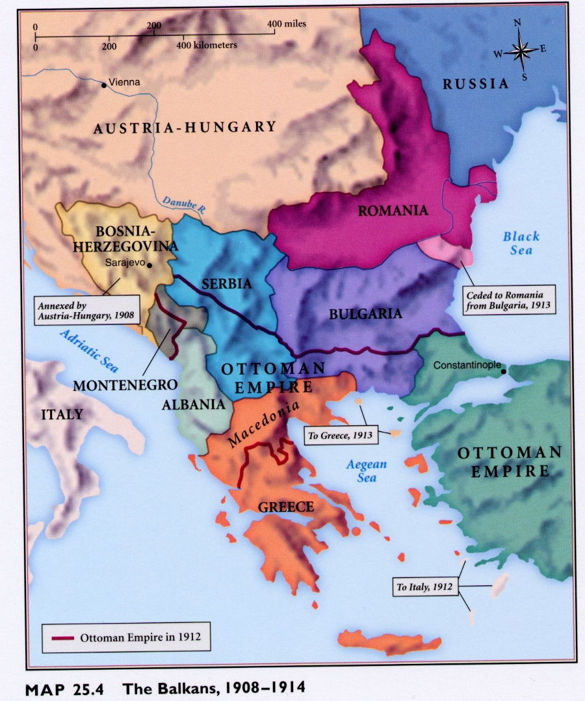
The Balkans 1908-1914
Notes:
Balkans were dominated by Austria-Hungary and the Ottoman Empire
Nationalism caused ethnicities to demand independence → various rebellions and conflicts
Serbia was independent and encouraged uprisings, hoping to increase its own territory
Russia also encouraged uprisings because it wanted to weaken Austria-Hungary and the Ottoman Empire and gain access to the Straits of the Bosporus
image: http://fc.greensboroday.org/~ldrewiczewing/Balkans1908to1914.JPG

Slide 30
military build-up
war hysteria
naval race
militarism
conflicts
nationalism
WW1
imperialism
Balkan Wars
alliances
imperial rivalries
blank check
mistrust
powers drawn into war
idea of war omnipresent

Slide 31
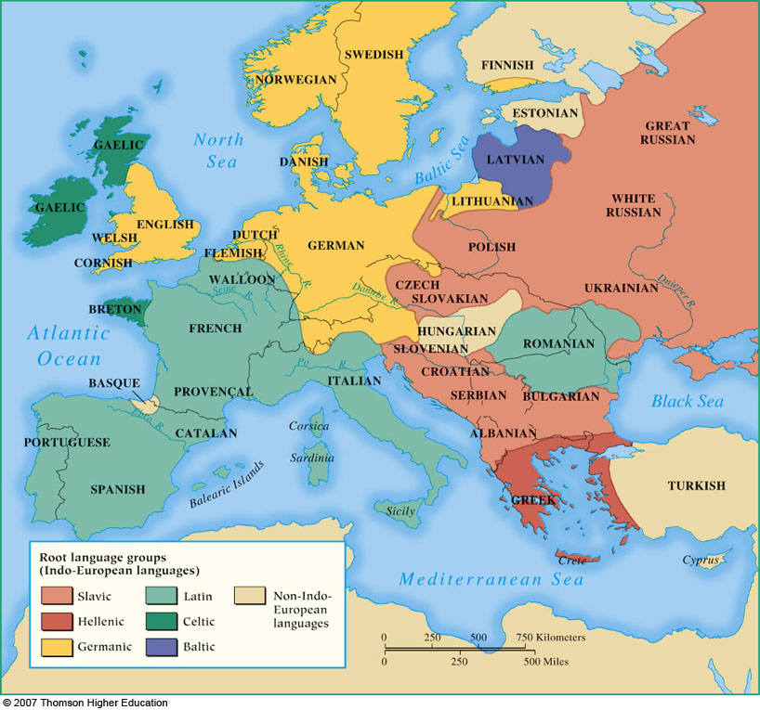
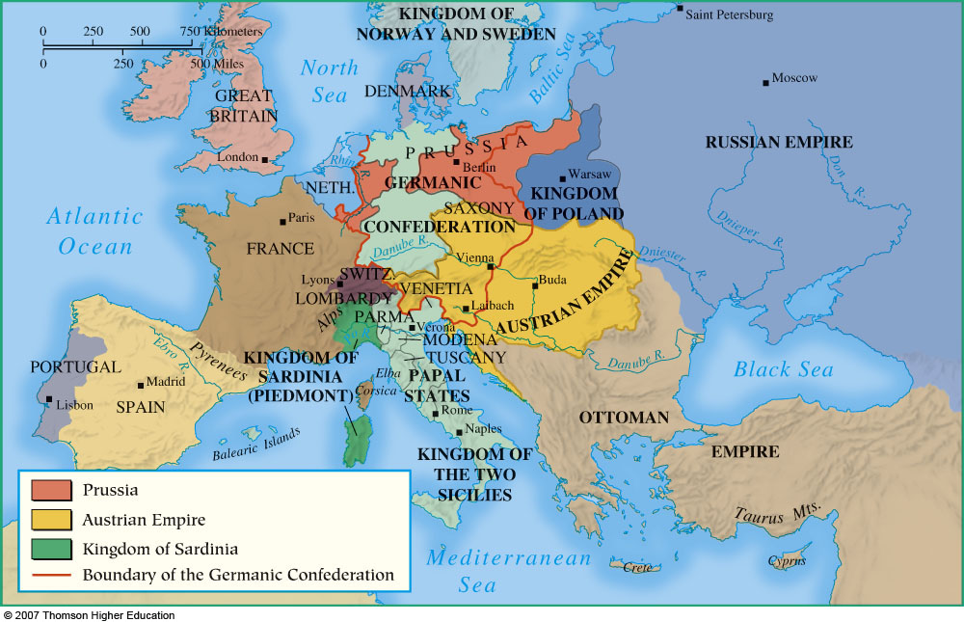
Notes:
nationalism clashed with multi-ethnic monarchies
in 1848, various revolutions tried to establish nation states (most failed) but nationalism led to unification of Italy (in 1861) and Germany (in 1871) as nation states
images from Jackson J. Spielvogel. Western Civilization: A Brief History (Belmont, 2008)⁴.

Slide 32
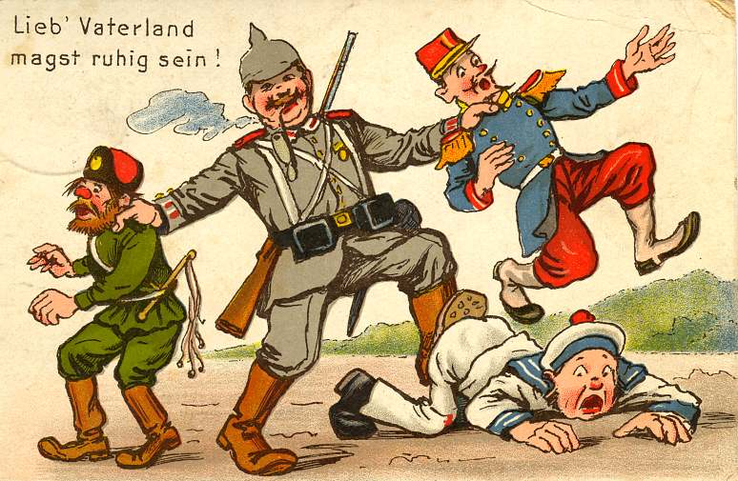
Notes:
ideas of national or ethnic superiority and increased nations’ willingness to beat rivals
image: http://cararcenas.files.wordpress.com/2012/03/26b-lieb-vaterland-magst-ruhig-sein.jpg

Slide 33
military build-up
war hysteria
naval race
militarism
conflicts
feelings of superiority
nationalism
WW1
imperialism
Balkan Wars
alliances
imperial rivalries
blank check
mistrust
powers drawn into war
idea of war omnipresent

Slide 34
On 28 June 1914, Franz Ferdinand, heir to the Austrian throne, was assassinated with his wife in Sarajevo, the capital of the Austro-Hungarian province of Bosnia.
Outbreak of the First World War

